Slide 1
PHP variables, data types and constants

Slide 2
PHP Basic Syntax
<?php
// PHP code goes here
?>
A PHP script starts with <?php and ends with ?>

Slide 3
PHP Variables
Variables are used to store data, like string of text, numbers, etc. Variable values can change over the course of a script. Here're some important things to know about variables:
In PHP variable can be declared as: $var_name = value;
Variables are also known as containers as these containers are containing some values and the name of the container is the variable name.

Slide 4
PHP Variables
Variables in PHP starts with the $ symbol, followed by the name of the variable.
Unlike other programming languages, PHP has no command for declaring a variable. It is created the moment you first assign a value to it.
For example:
$a=5;
$b=“Akshay”;

Slide 5
PHP Variables
How do variables get their data type in PHP?
By looking at the value of the variable.
For example: $a=5; the data type of the variable $a is an integer.
For example: $b= “Akshay”; the data type of the variable $a is a string.
For example: $a=5.22; the data type of the variable $a is an float or double.

Slide 6
Naming Conventions for PHP Variables
These are the following rules for naming a PHP variable:
All variables in PHP start with a $ sign, followed by the name of the variable.
A variable name must start with a letter or the underscore character _.
A variable name cannot start with a number.
A variable name in PHP can only contain alpha-numeric characters and underscores (A-z, 0-9, and _).
A variable name cannot contain spaces.
PHP variables are case-sensitive, so $name and $NAME both are treated as different variable.

Slide 7
PHP Variables
Here are a few correct examples:
$userName – Camel case, often used in PHP for readability.
$total_amount – Snake case, commonly used for variable names with multiple words.
$_tempValue – Starting with an underscore, which is allowed.
$isLoggedIn – Boolean variable naming, often starts with "is" or "has".
$counter1 – Variable name with a number at the end.

Slide 8
PHP Variables
Here are some incorrect examples of PHP variable names and why they are invalid:
$1stValue : Variable names cannot start with a number.
$Total-amount : Hypens (-) are not allowed.
$@username : special characters are not allowed, except underscore ( _ ).

Slide 9
PHP Variables
Here are some incorrect examples of PHP variable names and why they are invalid:
$user name : Spaces are not allowed in variable names.
$class : Technically correct but problematic as the term ‘class’ is a reserved keyword in PHP which causes ambiguity.
$var#1 : The # symbol is not allowed in the variable name.

Slide 10
Data Types in PHP
What is data type?
In PHP, a data type refers to the classification of the type of data that a variable can hold.
There are 4 types of data types in PHP
Scalar data type
Compound data type
Special data type
Pseudo data type

Slide 11
Scalar Data Types in PHP
Scalar data types variables are those variables which can hold only single value.
Types of scalar data type variables:
Integer
Float(also known as doubles in PHP)
String
Boolean

Slide 12
PHP Integers
In PHP, an integer is a data type that represents whole numbers without any fractional or decimal components.
Integers can be positive, negative, or zero.
Integers are whole numbers, without a decimal point
(..., -2, -1, 0, 1, 2, ...).

Slide 13
PHP Integers
Characterstics of integers:
Whole number
Range
Base representations
Arithmatic operations
Type conversion
Signed and unsigned
Memory usage

Slide 14
PHP Integers Example
<?php
$positiveInt = 123; // A positive integer
$negativeInt = -456; // A negative integer
$zero = 0; // Zero
$hexInt = 0x1A; // A hexadecimal integer (26 in decimal) $octalInt = 0755; // An octal integer (493 in decimal) $binaryInt = 0b1010; // A binary integer (10 in decimal)
echo $positiveInt; // Outputs: 123
echo $hexInt; // Outputs: 26
?>

Slide 15
PHP Floating Point Numbers or Doubles
Floating point numbers (also known as "floats", "doubles", or "real numbers") are decimal or fractional numbers
Characterstics of floating point numbers:
Fractional or decimal number
Range
Precision
Arithmatic operations
Type conversion
Signed and unsigned
Memory usage
Roundings and precision issues
floating point functions

Slide 16
PHP Floating Point Numbers
Common functions in floating point numbers:
is_float() or is_double()
round()
floor()
ceil()
number_format()

Slide 17
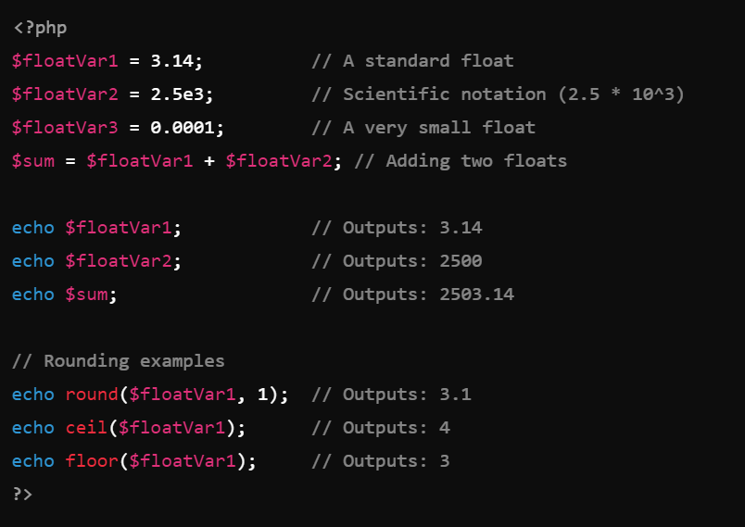
Examples of Floating Point Numbers in PHP

Slide 18
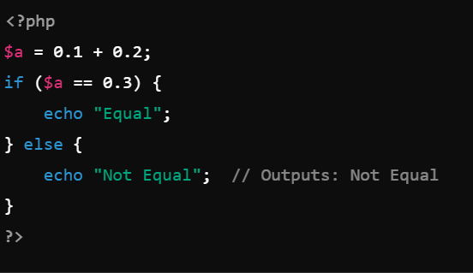
Examples of Floating Point Numbers in PHP

Slide 19
PHP Strings
Strings are sequences of characters, where every character is the same as a byte.
A string can hold letters, numbers, and special characters and it can be as large as up to 2GB.
The simplest way to specify a string is to enclose it in single quotes (e.g. 'Hello world!'), however you can also use double quotes ("Hello world!").
PHP provides a powerful set of functions to manipulate strings, making it easy to handle text in various formats and contexts.

Slide 20
PHP Strings
Characterstics of strings:
Delimeters : Single quotes or double quotes.
String concatenation : done by dot operator.
Variable interpolation
Escape sequences : \n, \t, \\, \’, \”,\$.
String functions : PHP provides a powerful set of functions to manipulate strings, making it easy to handle text in various formats and contexts.

Slide 21
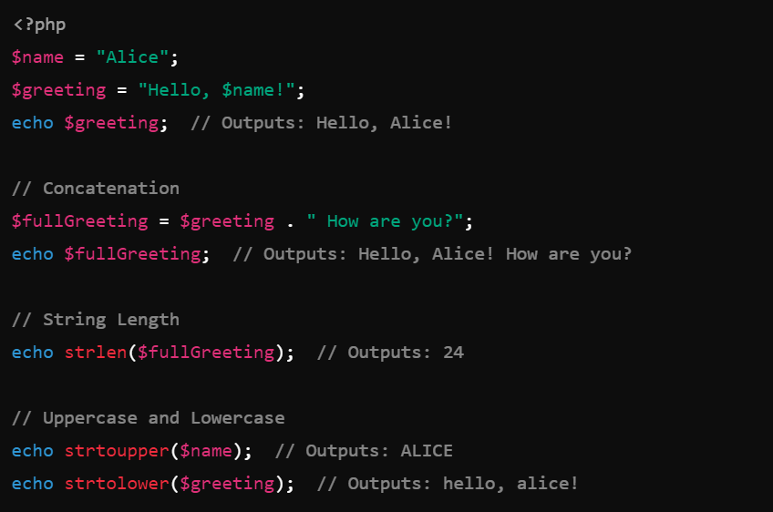
PHP Strings
Implementation of string functions:

Slide 22
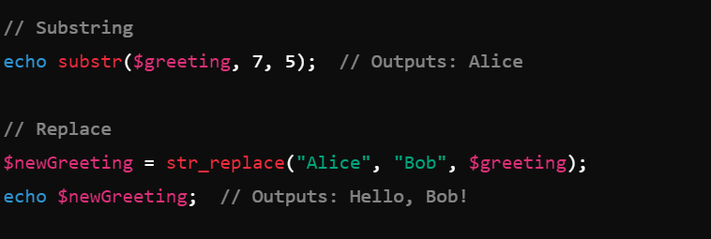
PHP Strings

Slide 23
PHP Booleans
In PHP, a boolean is a data type that can hold one of two possible values either ‘True’ or ‘False’.
Booleans are commonly used in conditional statements and logical operations to control the flow of a program.
Characterstics of Booleans:
Values : Only 2 values true or false.
Case insensitive

Slide 24
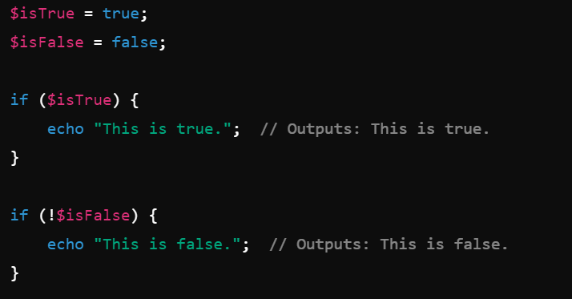
PHP Booleans

Slide 25
Compound Data Types in PHP
Compound data type variables are those variables which can hold multiple values.
There are only 2 types of compound data type variables:
Arrays
Object

Slide 26
PHP Arrays
In PHP, an array is a data structure that allows you to store multiple values in a single variable.
Arrays can hold various data types, including integers, strings, objects, and even other arrays. PHP arrays are highly flexible and can be indexed by numbers (numeric keys) or by strings (associative arrays).
Types of arrays:
Indexed Arrays
Associative arrays
Multidimensional arrays

Slide 27
PHP Arrays
Indexed Arrays :
Arrays with numeric keys starting from 0.
Keys are automatically assigned if not specified.
<?php
$fruits = ["Apple", "Banana", "Cherry"]; echo $fruits[0];
?>
Output : Apple

Slide 28
PHP Arrays
Associative Arrays:
Arrays where the keys are strings.
When you want to associate with specific named keys.
<?php
$person = [
"name" => "John",
"age" => 30,
"city" => "New York"
];
echo $person["name"];
?>
Output : John

Slide 29
PHP Arrays
Practical Use Cases:
Storing Collections of Data: Arrays are useful for storing collections of related data, such as lists of items, user data, or configurations.
Data Mapping: Associative arrays are ideal for mapping data, such as user profiles, settings, or translations.
Handling Forms: Arrays are commonly used to handle form data, where each field corresponds to an array element.

Slide 30
PHP Object
An object is a data type that not only allows storing data but also information on, how to process that data.
An object is a specific instance of a class which serve as templates for objects.
Objects are created based on this template via the new keyword.
Every object has properties and methods corresponding to those of its parent class.
Every object instance is completely independent, with its own properties and methods, and can thus be manipulated independently of other objects of the same class.

Slide 31
Special Data Type Variable in PHP
There are two special data type variable:
Resouce variable : A ‘resource’ is a special data type variable which is used to holds the refrence of external files. This might be a connection to a database, a file handle, a connection to an external server, or any other kind of external connection or stream.
Null Variable : The ‘NULL’ data type variable with no value. It can have only one possible value ie, NULL.

Slide 32
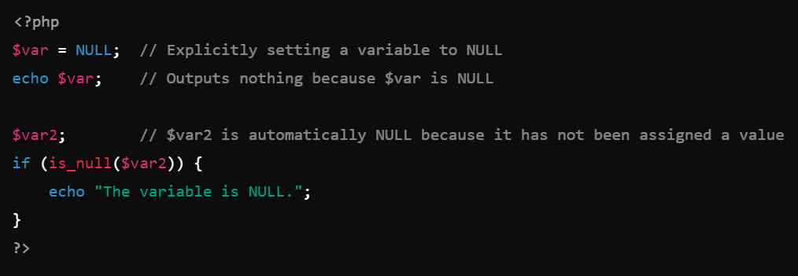
NULL Data Type in PHP

Slide 33
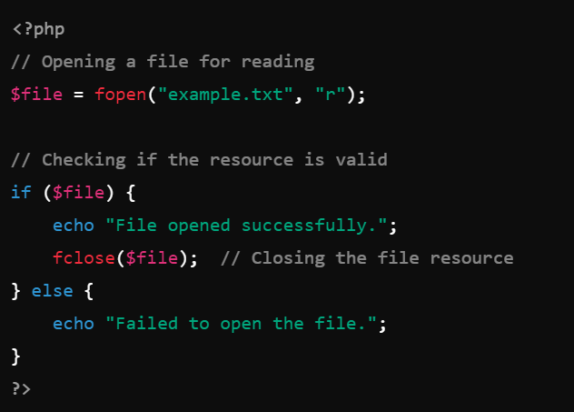
Resource Data Type in PHP

Slide 34
Resource in PHP
Uses of Resource data type variable:
fopen() : for opening a file.
mysql_connect() : for connecting databases.
imagecreate() : for linking images.

Slide 35
NULL in PHP
Uses of NULL data type variable:
Uninitialized variable : A variable that has not been initialized is automatically set to null.
Resetting variable : setting a variable to null which effectively clears the value of the variable.
Function Return Values: Some functions return null to indicate an error or the desired output is not found.

Slide 36
Constants
A constant is a name or an identifier for a fixed value.
Constant are like variables, except that once they are defined, they cannot be undefined or changed.
PHP constants can be defined by 2 ways:
- Using define() function
- Using const keyword

Slide 37
Constants(contd.)
PHP constant: define() - Use the define() function to create a constant. It defines constant at run time.
define(name, value)
- name: It specifies the constant name.
- value: It specifies the constant value.

Slide 38
Constants(contd.)
<?php
// case-sensitive constant name
define("WISHES", "Good Evening");
echo WISHES;
?>
OUTPUT:
Good Evening

Slide 39
Constants(contd.)
PHP constant: const keyword - PHP introduced a keyword const to create a constant. The const keyword defines constants at compile time. It is a language construct, not a function. The constant defined using const keyword are case-sensitive.
<?php
const WISHES="Good day";
echo WISHES;
?>
OUTPUT:
Good day

Slide 40
Constants(contd.)
Constant() function - There is another way to print the value of constants using constant() function.
The syntax for the following constant function:
constant (name)

Slide 41
Constants(contd.)
<?php
define("WISHES", "Good Evening");
echo WISHES. "<br>";
echo constant("WISHES");
//both are similar
?>
OUTPUT:
Good Evening
Good Evening

Slide 42
Constants(contd.)
PHP Constant Arrays - In PHP, you can create an Array constant using the define() function.
<?php
define("courses", [
"PHP",
"HTML",
"CSS"
]);
echo courses[0];
?>
OUTPUT:
PHP

Slide 43
Constants(contd.)
PHP Constant Arrays - In PHP, you can also create an Array constant using const keyword.
<?php
const WISHES=array("PHP",
"HTML",
"CSS");
echo WISHES[0];
?>
OUTPUT:
PHP

Slide 44
Constants(contd.)
Constants are Global - Constants are automatically global and can be used across the entire script.
<?php
define("WISHES", "Good Evening");
function test() {
echo WISHES;
}
test();
?>
OUTPUT:
Good Evening

